Slide 1
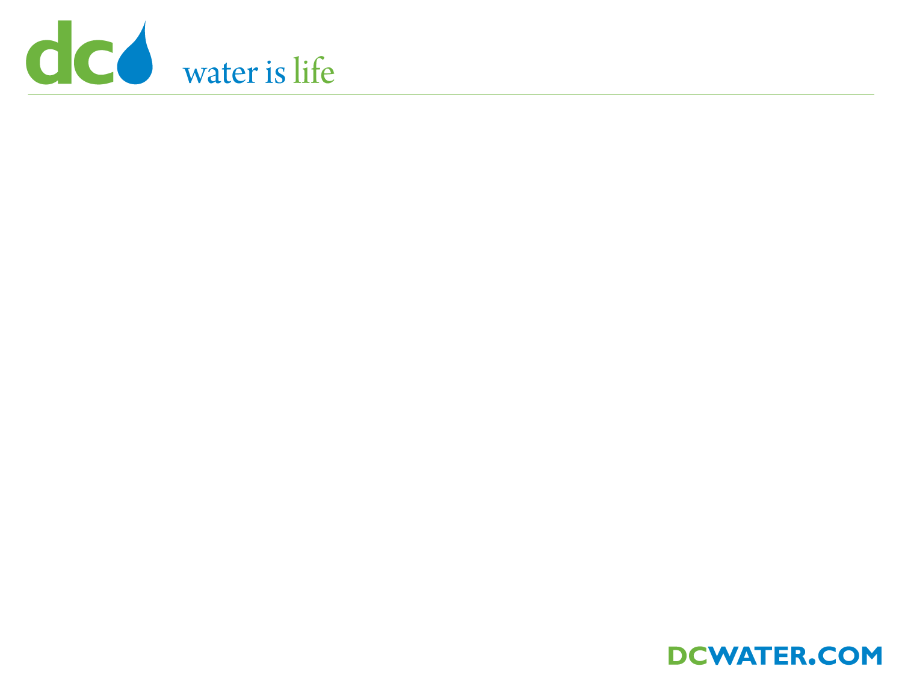

District of Columbia Water and Sewer Authority
George S. Hawkins, General Manager
Briefing on:
DC CLEAN RIVERS PROJECT
Anacostia River Projects
Division E – M Street Diversion Sewer
(CSOs 015, 016 and 017)
Briefing for:
CAPITAL RIVERFRONT BUSINESS IMPROVEMENT DISTRICT
June 20, 2011

Slide 2
Agenda
What is a CSO?
Overview of CSO Program
DC Clean Rivers Project Snapshot
M Street Diversion Sewer (CSOs 015, 016 and 017)

Slide 3
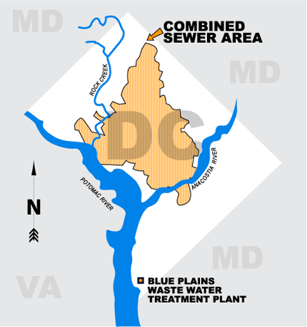
Combined Sewer Area
1/3 area is combined (12,478 acres)
53 CSO outfalls
  15 to Anacostia
  10 to Potomac
  28 to Rock Creek
Three receiving waters
  Anacostia River
  Potomac River
  Rock Creek

Slide 4
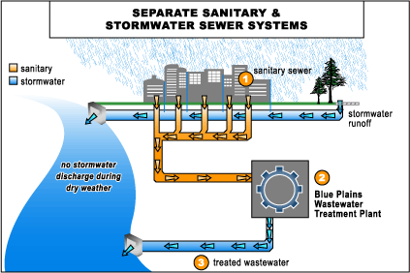
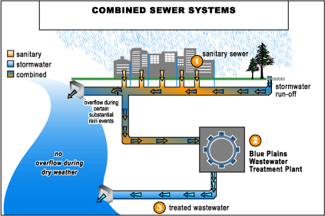
What is a CSO?
100% of Suburbs
67% of DC
0% of suburbs
33% of DC

Slide 5
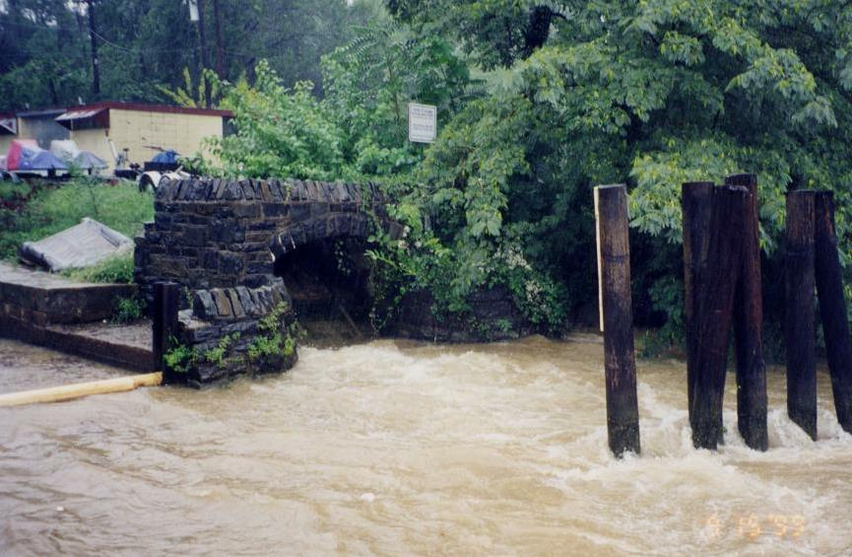
Why are CSOs a Concern?
Can adversely affect quality of receiving waters
Primary concerns:
  Bacteria levels
  Contribute to low dissolved oxygen in water
    Potential for fish stress or fish kills
    Affects other aquatic life
  Aesthetics – contributes to trash on waterways
CSO 017 discharging to the Anacostia River during Hurricane Floyd

Slide 6
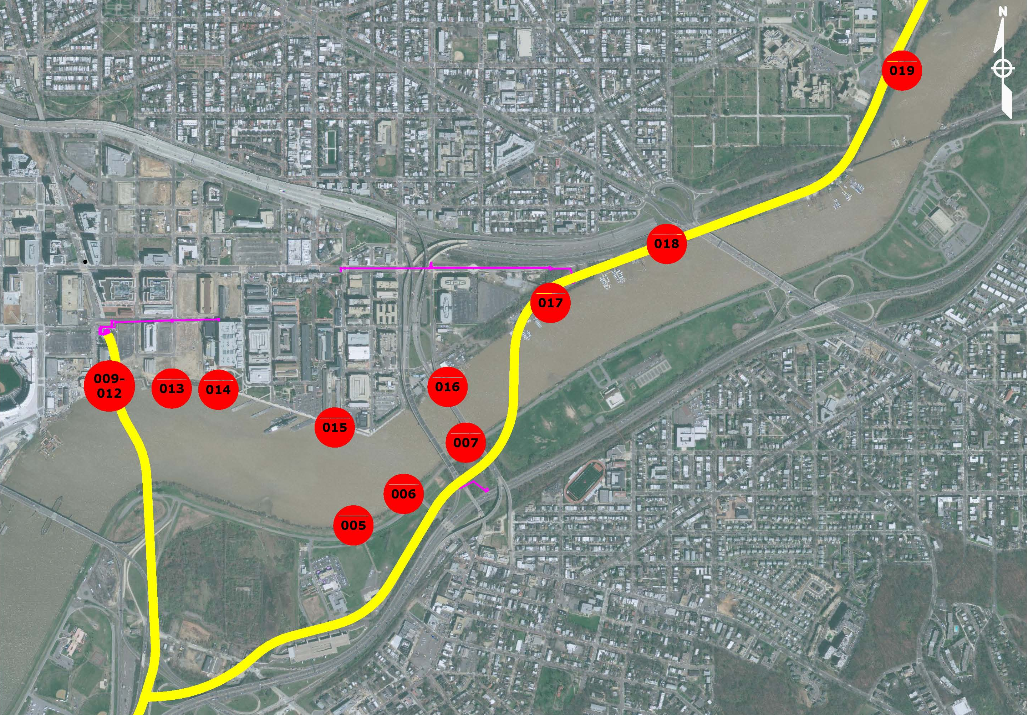
Overview of CSO Program
Anacostia River CSOs
Pennsylvania Avenue
Congressional
Cemetery
Interstate 395
Sousa Brg
Nationals
Stadium
Anacostia River
Interstate 295
11th St Brg
S Capitol St Brg

Slide 7

Project Snapshot
SOUTH OF RFK
Anacostia River
Projects
Most severely impacted by CSOs
Storage & Conveyance Tunnel System
2018
2025
Potomac & Rock Creek Projects
Storage Tunnels
NORTH OF RFK
2025
ENTIRE SYSTEM IN OPERATION

Slide 8
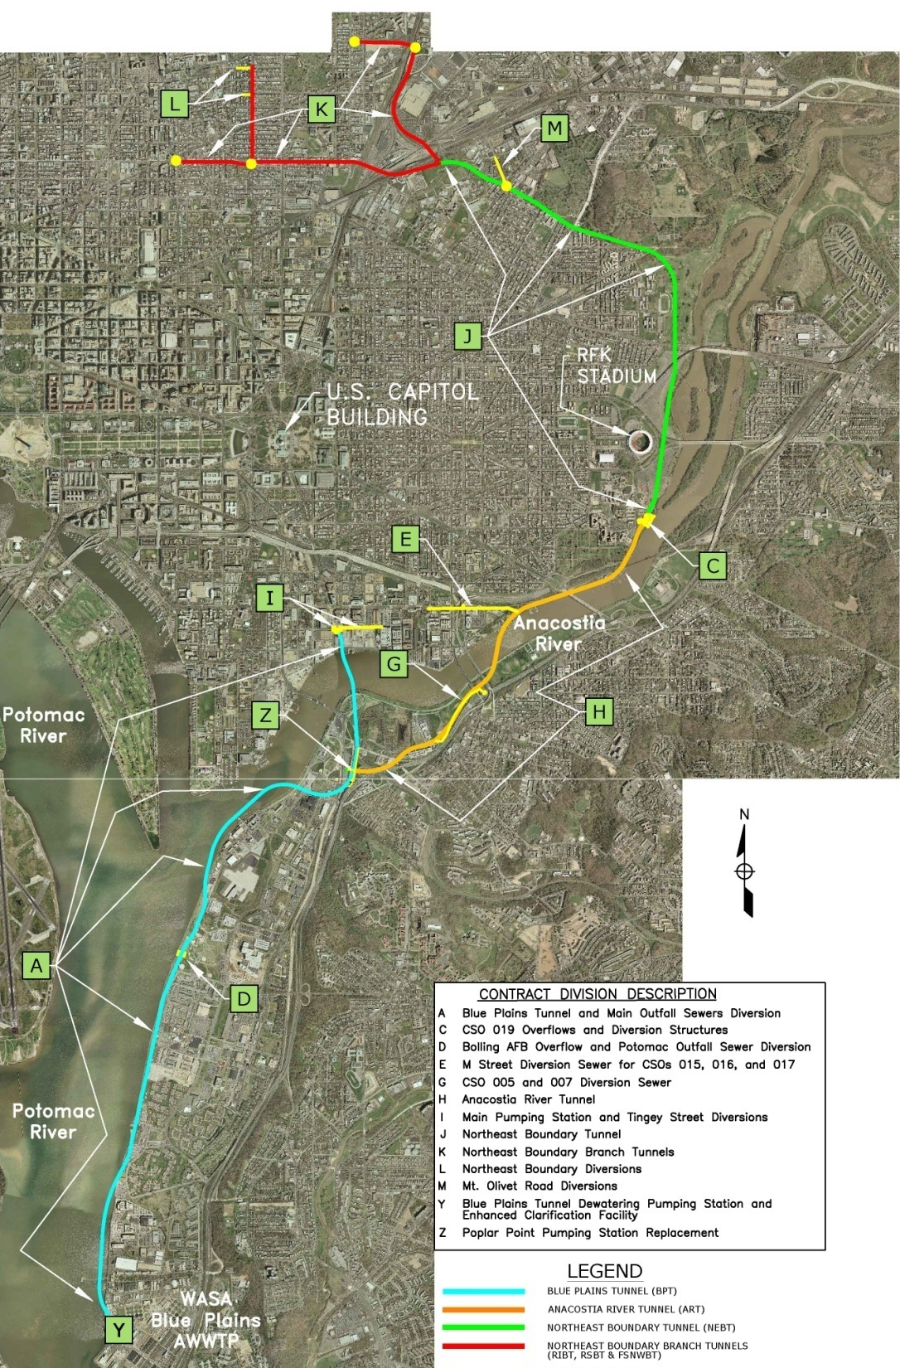
Project Snapshot
Long Term Control Plan (LTCP)
  Control combined sewer overflows (CSOs)
  Reduce flooding
  Meet nutrient discharge limits of Chesapeake Bay Program
Schedule
  LTCP = 20 years (2005-2025)
  Nitrogen = 2007-2015
Cost
  LTCP = $2.5 billion
  Nitrogen = $950 M
  Total > $3.5 billion
Drivers
  Projects required to meet regulatory requirements (NPDES Permit and Consent Decrees)
A Blue Plains Tunnel
C CSO 019 Overflow and Diversion Structures
D JBAB Overflow and Potomac Outfall Sewer Diversion
E M Street Diversion Sewer (CSOs 015, 016 and 017)
G CSO 007 Diversion Structure and Diversion Sewer
H Anacostia River Tunnel
I Main Pumping Station and Tingey Street Diversions
J Northeast Boundary Tunnel
K Northeast Boundary Branch Tunnels
L Northeast Boundary Diversions
M Mt. Olivet Road Diversions
Y Blue Plains Dewatering Pumping Station and ECF
Z Poplar Point Pumping Station Replacement

Slide 9
Other Clean Rivers Projects in the area

Slide 10
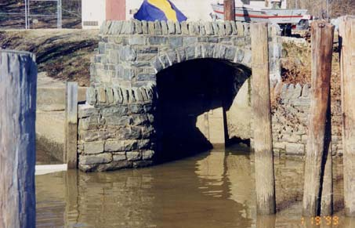
M Street Diversion Sewer
Purpose
Intercept CSO 015, 016 and 017 and convey flows to Anacostia River Tunnel (ART)
CSOs to be “consolidated”
  Divert full capacity of drainage area and convey to tunnel
  Removable bulkhead on outfall to river at diversion structure
  Remove bulkhead if maintenance of tunnel or appurtenances needed
CSO 017 Outfall @ Anacostia River

Slide 11
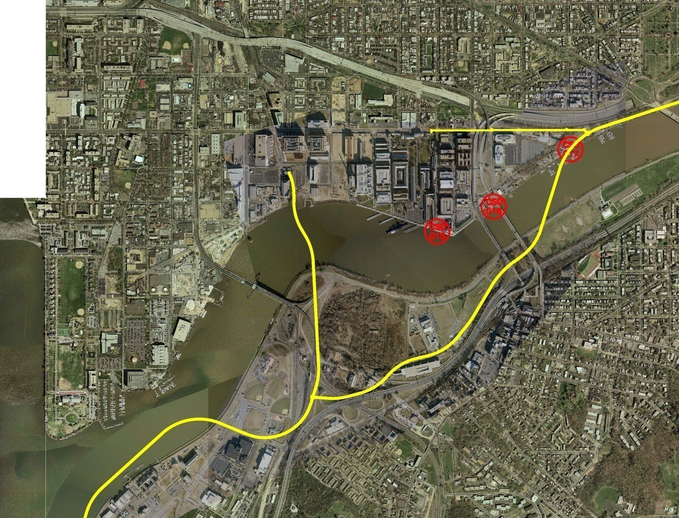
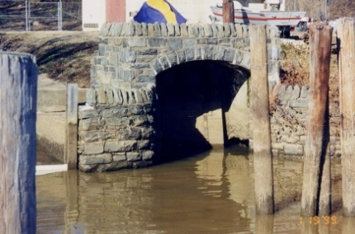
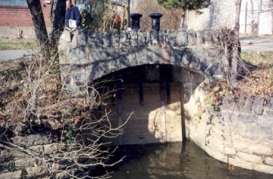
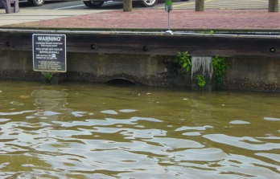
M Street Diversion Sewer
Project Location
Project Site
CSO
017
River
CSO
016
CSO
015
Anacostia
Potomac River

Slide 12
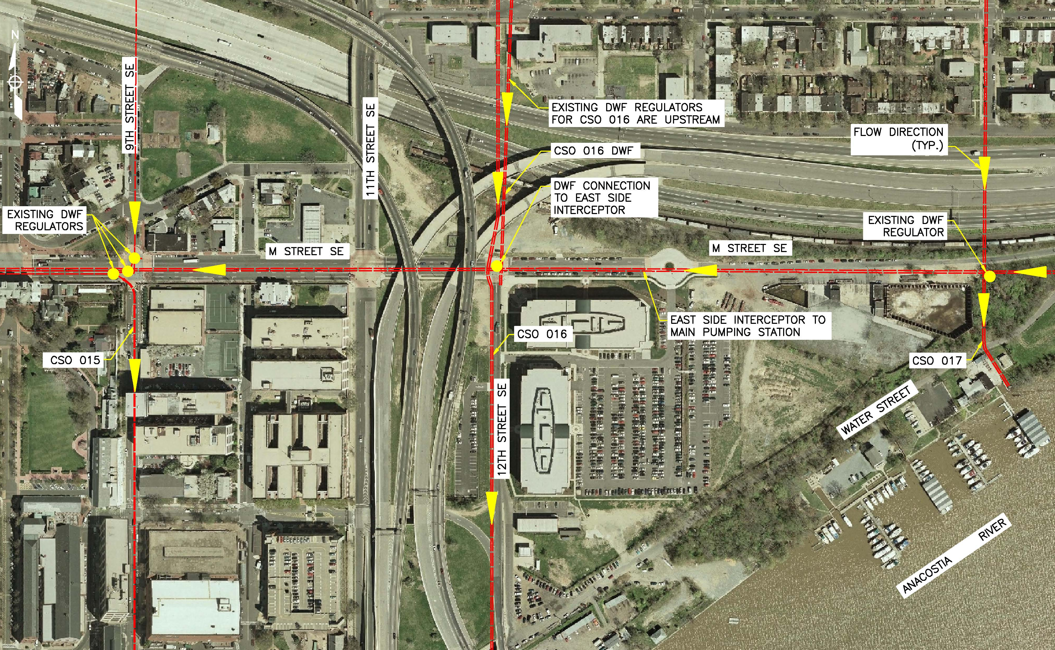
M Street Diversion Sewer
Existing Sewer System – CSOs 015, 016 and 017
12

Slide 13
M Street Diversion Sewer
Alignment
N

Slide 14
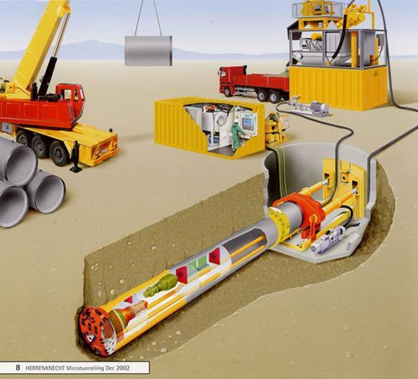
M Street Diversion Sewer
Construction Methods
Diversion sewer construction using trenchless technology
  Techniques for utility line installation, replacement, rehabilitation, inspection, location, and leak detection, with minimal excavation from the ground surface
  Less surface disruption
  Reduces environmental impacts
  Limits impacts to existing structures and utilities
  Reduce need for dewatering
  Reduce amount of excavated material
  Diversion Sewer length = 2,632-ft
  Diversion Sewer depth = 20 to 45-ft
  Construction of diversion chambers requires open-cut at three sites along alignment:
  9th and M Streets SE
  12th and M Street SE
  14th Street ROW and M Street SE

Slide 15
U.S. Reservation 251
Estimated Construction: October 2012 – February 2013
Key Plan
CSO 015
Construction Staging Area

Slide 16
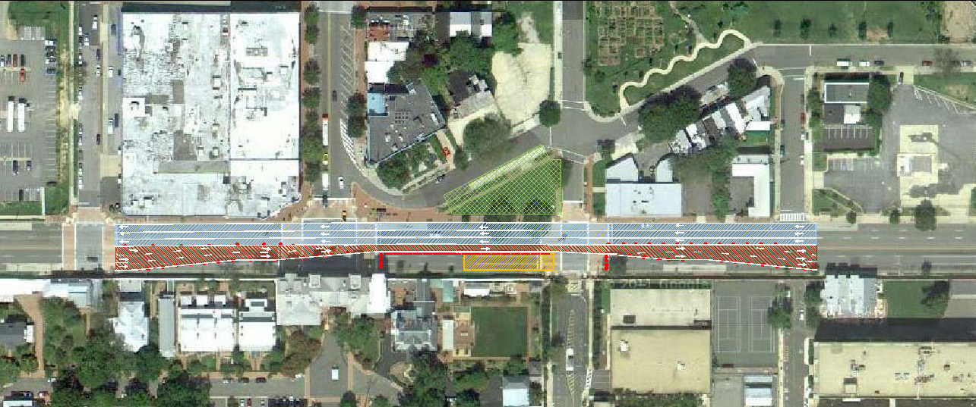
M Street Diversion Sewer
MOT for Structure 19 (AM Rush Hour)
Estimated Construction Period:
Dec 2012 to Feb 2013
7 TH ST. SE
8 TH ST. SE
9 TH ST. SE
10 TH ST. SE
REMOVE BUS STOP
DEMOLISH MEDIAN
STAGING AREA
DEMOLISH MEDIAN
RESUME NORMAL TRAFFIC PATTERN
POTOMAC AVE. SE
M STREET SE
M STREET SE
CONSTRUCTION ZONE
NEW BUS STOP
RESUME NORMAL TRAFFIC PATTERN
RELOCATE BUS STOP
9TH STREET GATE
Maintain 4 lanes of traffic – 3 westbound, 1 eastbound (AM)
Maintain South Sidewalk / protect Historic Wall
Reduced South Construction Zone (Navy Residences)
Relocate Bus Stop

Slide 17
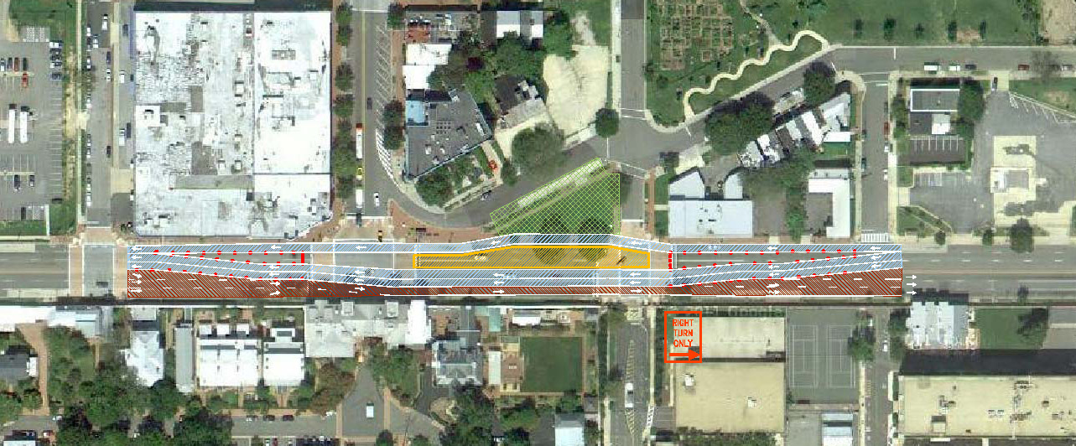
M Street Diversion Sewer
MOT for Structure 19A (AM Rush Hour)
Estimated Construction Period:
Oct 2012 to Dec 2012
7 TH ST. SE
8 TH ST. SE
9 TH ST. SE
REMOVE BUS STOP
10 TH ST. SE
DEMOLISH MEDIAN
STAGING AREA
DEMOLISH MEDIAN
RESUME NORMAL TRAFFIC PATTERN
POTOMAC AVE. SE
REMOVE SIDEWALK
M STREET SE
M STREET SE
CONSTRUCTION ZONE
NEW BUS STOP
RESUME NORMAL TRAFFIC PATTERN
RELOCATE BUS STOP
9TH STREET GATE
Maintain 4 lanes of traffic – 3 westbound, 1 eastbound (AM)
Maintain South Sidewalk / protect Historic Wall
Relocate Bus Stop
Right Turn out of 9th Street Gate only

Slide 18
U.S. Reservation 128
Estimated Construction: April 2012 – December 2013
CSO 016
Construction Staging Area
Key Plan

Slide 19
U.S. Reservation 343-D
Anacostia River
Estimated Construction: April 2012 – August 2013
CSO 017
Construction Staging Area
Key Plan

Slide 20
M Street Diversion Sewer
Coordination with DDOT’s 11th Street Bridge Project
DDOT and DC Water are working together to reduce impacts on public/private landowners
Coordination Efforts
  Preliminary design coordination
  Monthly coordination meetings during Final Design – current phase
  Schedule coordination
  Sharing of design files
Preliminary Design Review Meeting Process
Maintenance of Traffic and Traffic Study Guidance
  Maintain 4 lanes of traffic at the intersection of 9th and M Streets SE

Slide 21
M Street Diversion Sewer Schedule
Design – October 2010 through October 2011
Construction – April 2012 through December 2013
Anacostia River Projects | CY 2010 |  |  |  | CY 2011 |  |  |  | CY 2012 |  |  |  | CY 2013 |  |  |  | CY 2014 |  |  |  | CY 2015
 | 1 | 2 | 3 | 4 | 1 | 2 | 3 | 4 | 1 | 2 | 3 | 4 | 1 | 2 | 3 | 4 | 1 | 2 | 3 | 4 | 1 | 2 | 3 | 4
M Street Diversion Sewer
Design
Procurement
Construction
Current Status = 95% Design

Slide 22
Next Steps
Complete Final Design
Bid/Award Construction – November/December 2011
Continue Public Outreach Program

